Slide 1
Beyond Keyword Search: Discovering Relevant Scientific Literature
Khalid El-Arini and Carlos Guestrin
August 22, 2011
TexPoint fonts used in EMF.
Read the TexPoint manual before you delete this box.: AA

Slide 2
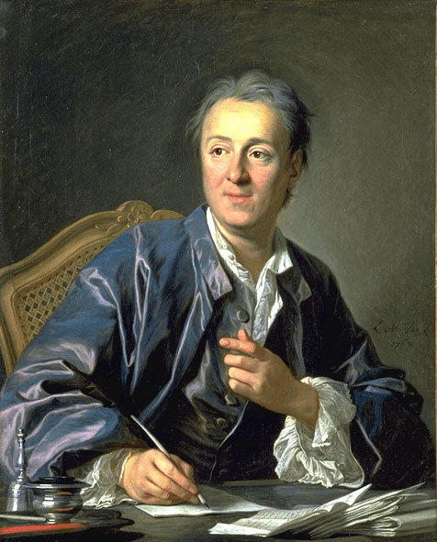
“It will be almost as convenient to search for some bit of truth concealed in nature as it will be to find it hidden away in an immense multitude of bound volumes.”
- Denis Diderot, 1755
Today:
10⁷ papers
10⁵ publications
[Thomson Reuters Web of Knowledge]

Slide 3


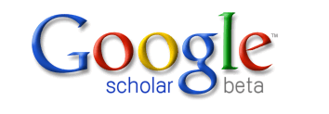



Keyword search is dominant…
…but is it natural?

Slide 4
Specific research question
Is there an approximation algorithm for the submodular covering problem that doesn’t require an integral-valued objective function?
Any recent papers influenced by this?

Slide 5
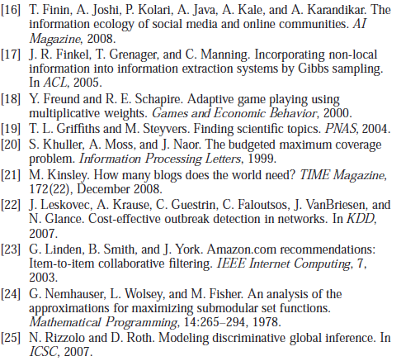
Literature review
It’s 11:30pm Samoa Time. Your “Related Work” section is a bit sparse.
Here are some papers we’ve cited so far.
Anything else?

Slide 6
Given a set of relevant query papers, what else should I read?

Slide 7
An example
seminal/background paper?
Cited by all
query papers
However, unlikely to find papers directly connected to entire query set.
We need something more general…
query set
Cites all
query papers
a competing approach?
Notes:
The query set

Slide 8
Select a set of papers A with maximum influence to/from the query set Q

Slide 9
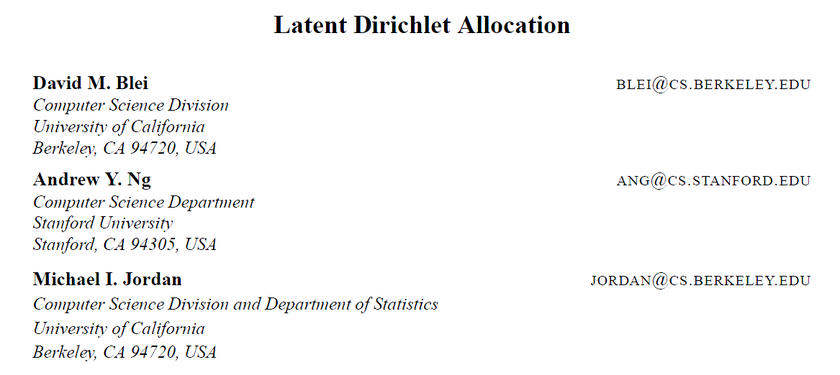
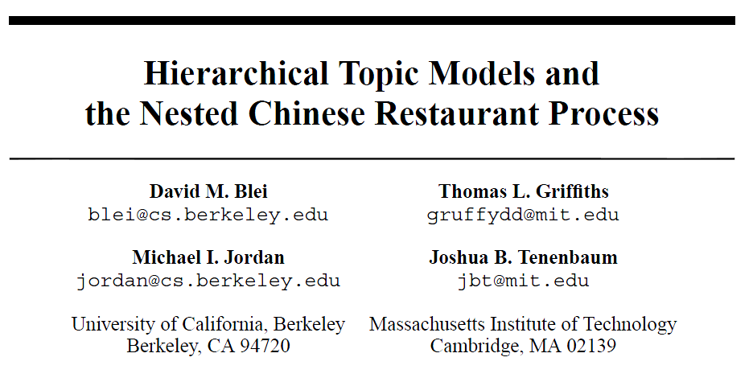
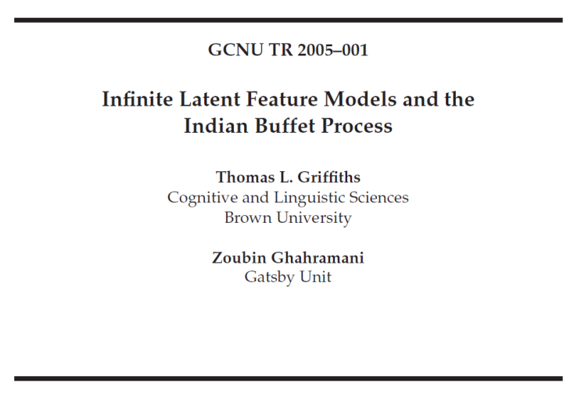
Modeling influence
Ideas flow from cited papers to citing papers

Slide 10
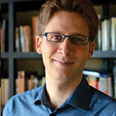
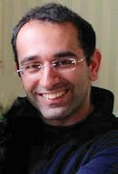
Modeling influence
Ideas flow from prior knowledge of the authors

Slide 11





Influence context
Why do I cite this paper?
generative model of text
variational inference
EM
…
we call these
concepts

Slide 12
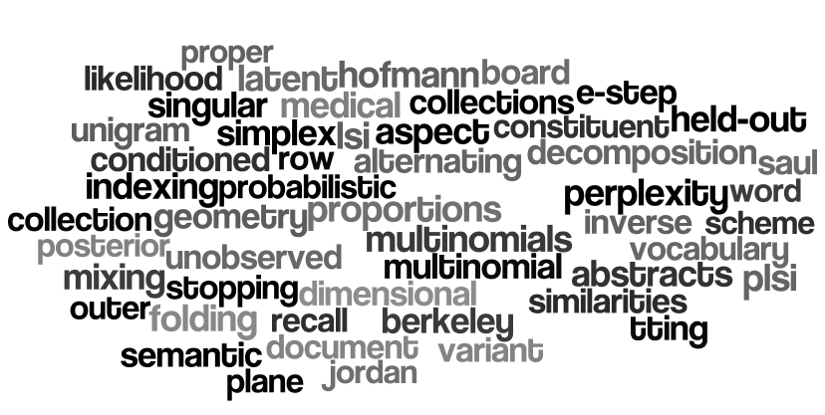
Concept representation
Words, phrases or important technical terms
Proteins, genes, or other advanced features
Our assumption:
Influence always occurs in the context of concepts

Slide 13
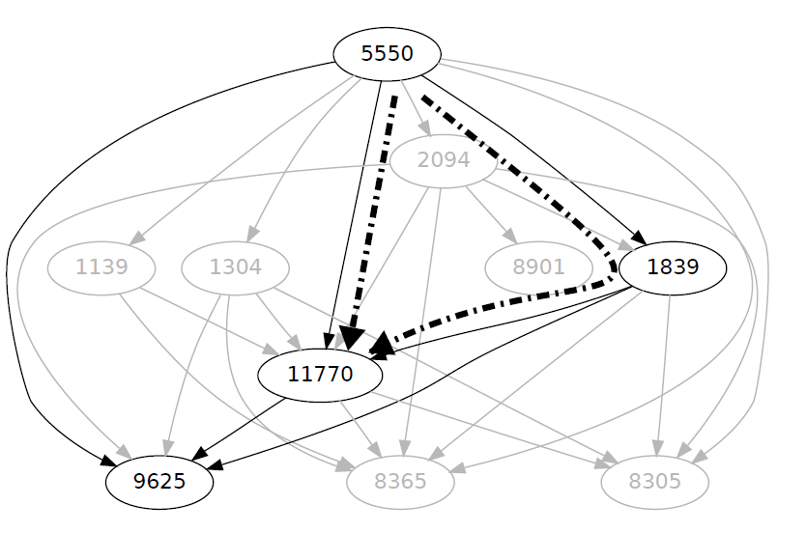
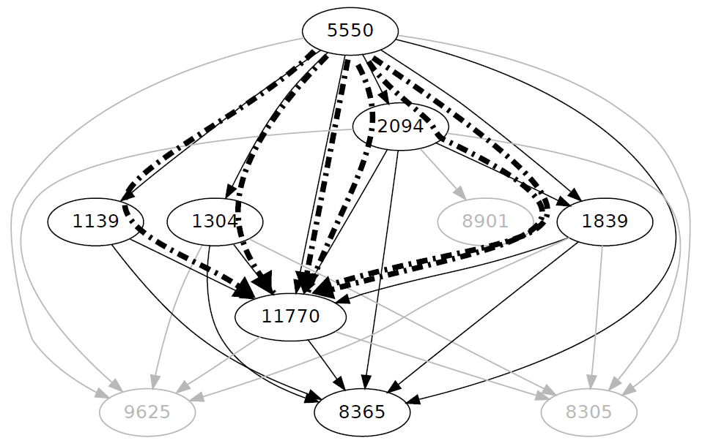
Influence by concept
Which shows more influence?
plant
stress
(Grayed-out nodes don’t contain the given concept)
Need to model the strength of each edge

Slide 14
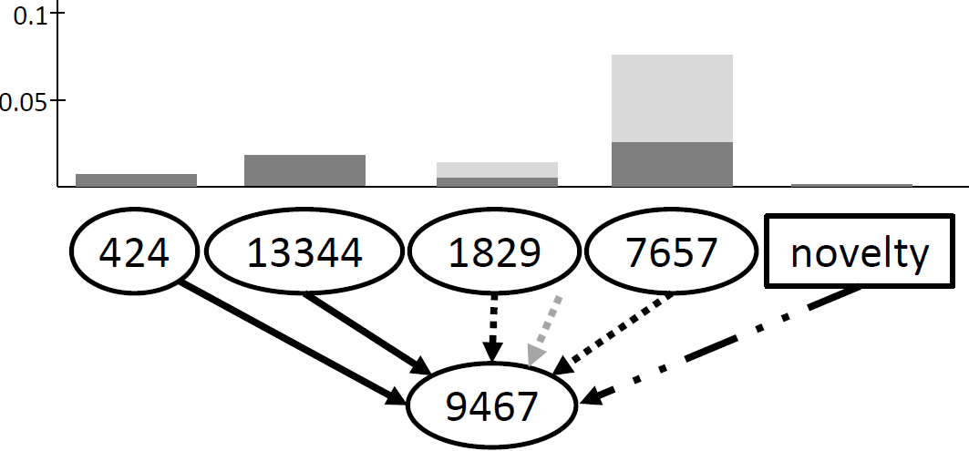
Influence strength
oxygen
direct citation
common authors

Slide 15
Influence strength
oxygen
(for normalization)

Slide 16
Influence strength
oxygen
prevalence of
“oxygen”
Direct citations more indicative of influence than previous papers of the authors

Slide 17
Influence strength
oxygen
prevalence of
“oxygen”
the weight between papers u and v w.r.t. concept c

Slide 18
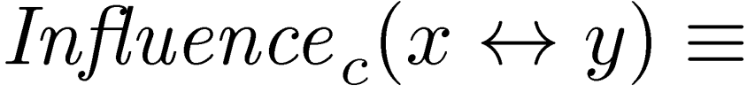

Influence strength
prob. of influence between x and y
with respect to concept c
plant
Influence exists if there is an active path between x and y (w.r.t. concept c)

Slide 19
Computing influence
Definition is intuitive, but intractable to compute exactly
#P-complete: the s-t network reliability problem
Approximations
Sampling
Sample complexity is provably logarithmic in size of corpus, but can still be slow in practice.
Independence heuristic
Fast, dynamic programming-based approach, but no explicit theoretical guarantees.

Slide 20
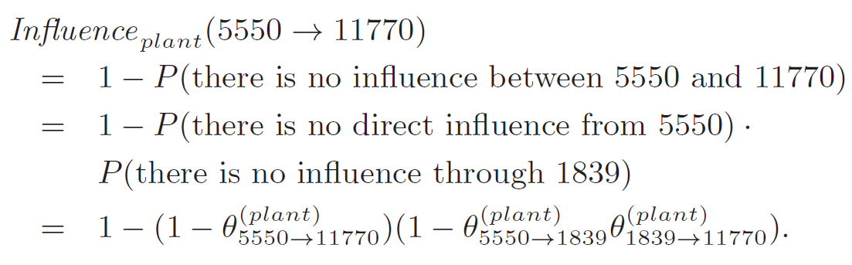
Independence heuristic
In some cases, we can compute the influence probability exactly:
Heuristic:
Assume all paths from x to y are independent of each other.
Given influence computed to parents, can compute influence to child in constant time.
Need just one linear pass through graph in topological order.
[In practice, closely matches results from sampling.]
plant
Exact because these two paths are independent

Slide 21
Recall:
Select a set of papers A with maximum influence to/from the query set Q
while maintaining:
- relevance
- diversity

Slide 22
Influence + Relevance
Influence should focus on relevant concepts:
Prevalent in query documents Q
Should be a main theme of some document in A

Slide 23
Influence + Relevance
Influence should focus on relevant concepts:
Prevalent in query documents Q
Should be a main theme of some document in A

Slide 24
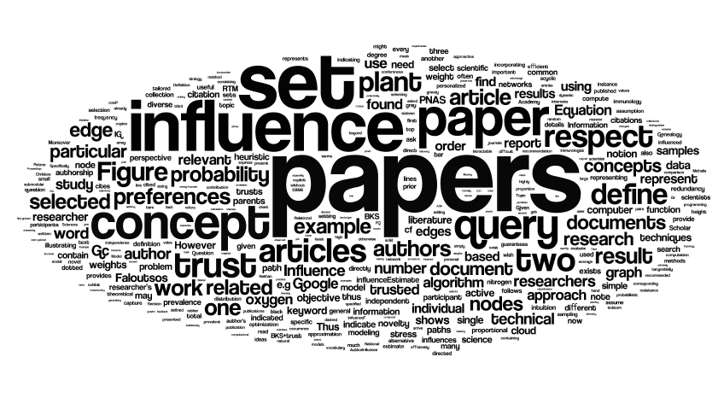
Influence + Relevance
Influence should focus on relevant concepts:
Prevalent in query documents Q
Should be a main theme of some document in A

Slide 25
Influence + Diversity
Why diversity?
Uncertainty about user’s information need
Different approaches/facets to same research problem
Notes:
- f(1) f(2) f(3) …. f(10) -> f(1,…,10)

Slide 26

Influence + Diversity
Why diversity?
Uncertainty about user’s information need
Different approaches/facets to same research problem
We take a probabilistic max cover approach
query papers
Notes:
- f(1) f(2) f(3) …. f(10) -> f(1,…,10)

Slide 27
Influence + Diversity
Why diversity?
Uncertainty about user’s information need
Different approaches/facets to same research problem
We take a probabilistic max cover approach
query papers
concepts
plant
oxygen
stress
plant
oxygen
stress
plant
oxygen
stress
Notes:
- f(1) f(2) f(3) …. f(10) -> f(1,…,10)

Slide 28
Influence + Diversity
Why diversity?
Uncertainty about user’s information need
Different approaches/facets to same research problem
We take a probabilistic max cover approach
query papers
concepts
plant
oxygen
stress
plant
oxygen
stress
plant
oxygen
stress
candidate
papers
Notes:
- f(1) f(2) f(3) …. f(10) -> f(1,…,10)

Slide 29
Influence + Diversity
Why diversity?
Uncertainty about user’s information need
Different approaches/facets to same research problem
We take a probabilistic max cover approach
query papers
concepts
plant
oxygen
stress
plant
oxygen
stress
plant
oxygen
stress
influence
candidate
papers
Notes:
- f(1) f(2) f(3) …. f(10) -> f(1,…,10)

Slide 30
Influence + Diversity
Why diversity?
Uncertainty about user’s information need
Different approaches/facets to same research problem
We take a probabilistic max cover approach
query papers
concepts
plant
oxygen
stress
plant
oxygen
stress
plant
oxygen
stress
influence
candidate
papers
Notes:
- f(1) f(2) f(3) …. f(10) -> f(1,…,10)

Slide 31
Set influence
31

Slide 32
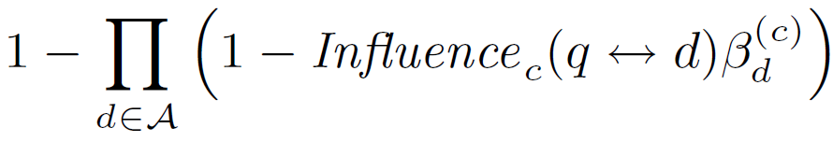
Set influence
32

Slide 33
Set influence
probability there exists
influence and relevance
33

Slide 34
Set influence
probability none of documents
exhibit influence or relevance
34

Slide 35
Set influence
probability at least one document
exhibits influence or relevance
35

Slide 36
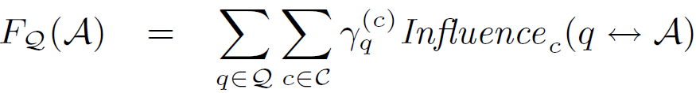
Putting it all together
Can now write objective function exactly describing what we want:
max
how do we solve this optimization?

Slide 37
Optimization
Our objective is submodular
an intuitive diminishing returns property
Using simple greedy algorithm, can maximize objective efficiently and near-optimally

Slide 38
Optimization
Our objective is submodular
B
+
S
Large improvement
A
+
S
Small improvement
For AµB, s∉B,
F(A [ {s}) – F(A) ¸ F(B [ {s}) – F(B)
Using simple greedy algorithm, can maximize objective efficiently and near-optimally
[slide credit: Andreas Krause]

Slide 39
Recap
query set
max
result set

Slide 40
But should all users get the same results?

Slide 41
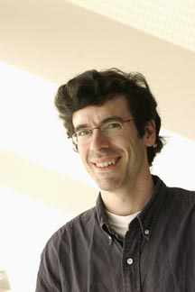
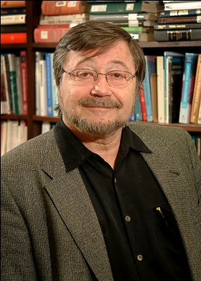
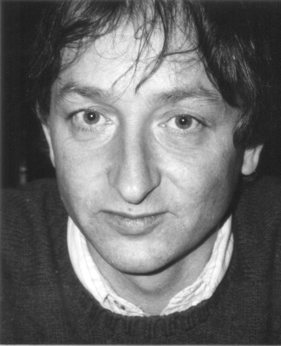
Personalized trust
Different communities trust different researchers for a given concept
Goal: Estimate personalized trust from limited user input
e.g., network
Pearl
Kleinberg
Hinton

Slide 42
Specifying trust preferences
Specifying trust should not be an onerous task
Assume given (nonexhaustive!) set of trusted papers B, e.g.,
a BibTeX file of all the researcher’s previous citations
a short list of favorite conferences and journals
someone else’s citation history!
a committee member?
journal editor?
someone in another field?
a Turing Award winner?

Slide 43
Given trusted set B, how much do I trust author a with respect to concept c?

Slide 44
Computing trust
How much do I trust Jon Kleinberg with respect to the concept “network”?
Kleinberg’s papers
An author is trusted if he/she influences the user’s trusted set B
B
0.2
0.4

Slide 45
Personalized Objective

Slide 46
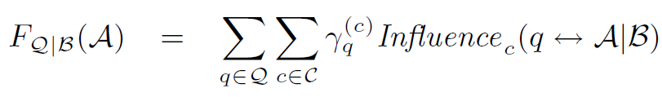
Personalized Objective
Does user trust at least one of
authors of d with respect to
concept c?

Slide 47
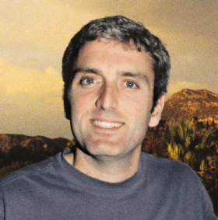
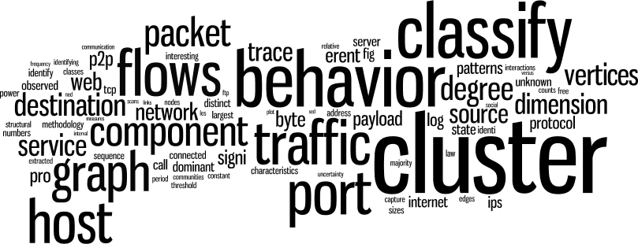
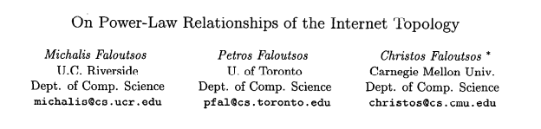
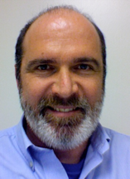
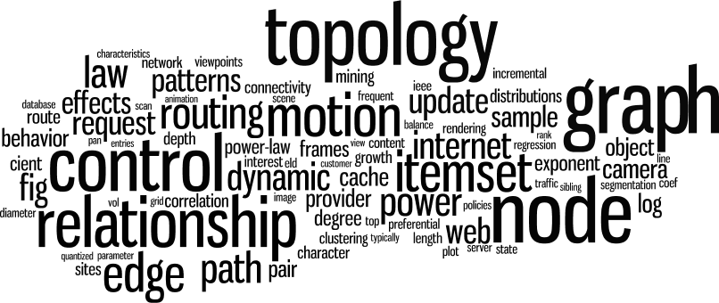
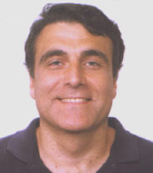
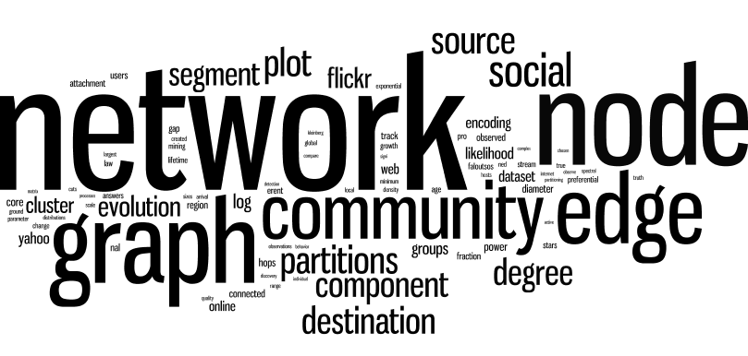
networks
graphics
data mining

Slide 48
User Study Evaluation
16 PhD students in machine learning
For each participant:
Select a recent paper for which we wish to find related work (the study paper)
Compare our algorithm and three state-of-the-art alternatives:
Relational Topic Model
Information Genealogy
Google Scholar
Show papers one at a time (double-blind), asking questions:
Would this paper have been useful to you when writing the study paper?
e.g.,

Slide 49
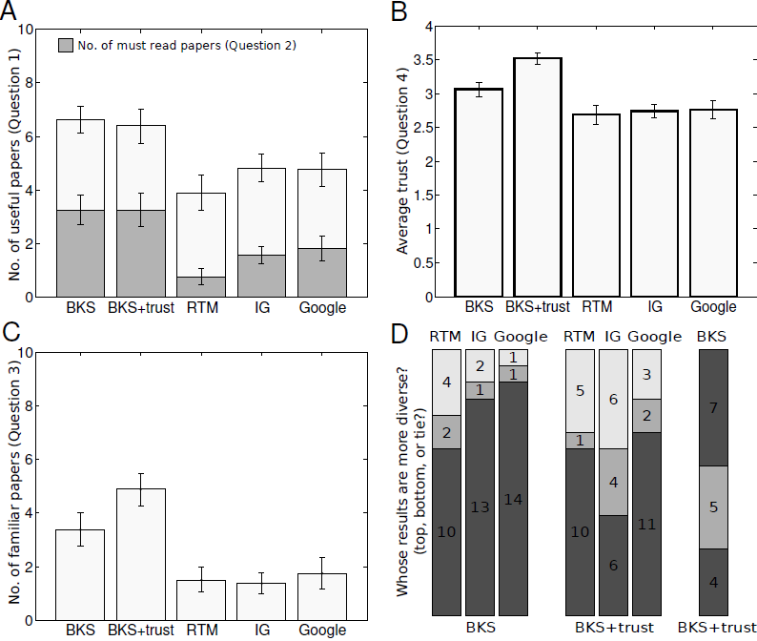
Usefulness
our approach
higher is better
Our approach provides more useful and
more must-read papers

Slide 50
Trust
our approach
higher is better
Our approach provides more trustworthy papers…

Slide 51
Novelty
our approach
…but at the expense of some novelty.

Slide 52
Diversity
Our approach produces more diverse results.

Slide 53
Summary
Often difficult to phrase information needs as keyword queries
Define query as small set of related papers
Efficiently optimize submodular objective function based on intuitive notion of influence to select highly relevant articles
Incorporate trust preferences to produce personalized results
Participants in user study found our method to be more useful, trustworthy and diverse than other popular alternatives.
live site coming soon!

