Slide 1
Transparent User Models for Personalization
Khalid El-Arini
Carnegie Mellon University
Joint work with:
Ulrich Paquet, Ralf Herbrich, Jurgen Van Gael, Blaise Agüera y Arcas

Slide 2












Personalization is ubiquitous.

Slide 3
Personalization is invaluable.
YouTube: 72+ hours/minute of new video
Facebook: 950 million+ users
Twitter: 400+ million tweets/day
Shopping:
[1994]: 500K unique consumer goods sold in U.S.
[2010]: Amazon alone offered 24 million.
Keyword search is not enough.
Notes:
As Sheena Iyengar points out in her book The Art of Choosing, in 1994 there were 500,000 different consumer goods for sale in the U.S. Now Amazon alone offers 24 million. Read more: http://www.time.com/time/magazine/article/0,9171,1992403,00.html#ixzz1WiIRH5aP

Slide 4
Personalization is often wrong.

Slide 5
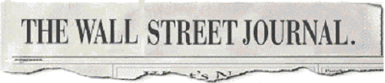
“Basil…is not a neo-Nazi.
Lukas…is not a shadowy stalker.
David…is not Korean.
intent on giving them such labels.”
- J. Zaslow, November 26, 2002

Slide 6
What recourse do we have?
“there's just one way to change its mind: outfox it.”
- J. Zaslow, November 26, 2002
Can we do better?

Slide 7
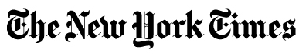


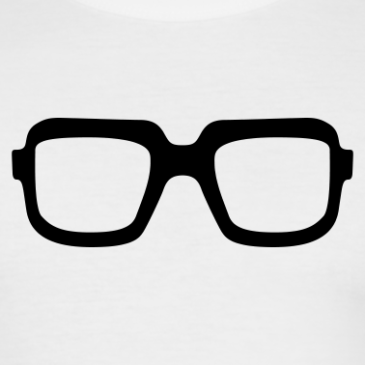
We propose an alternative.
Why am I getting this?
Vegan? Really? Why?
You behave like a
vegan hipster
You:
tweeted with #meatlessmonday
follow @WholeFoods
…

Slide 8
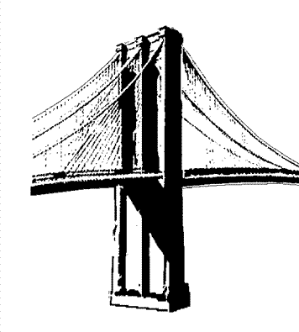
We propose an alternative.
Why am I getting this?
Goal:
Achieve transparency via interpretable user features, learned from user activity
You behave like a
Brooklyn hipster

Slide 9
Badges
Goal:
Achieve transparency via interpretable user features, learned from user activity
You behave like a
Brooklyn hipster

Slide 10
Approach
Model
Experiments
Summary
Notes:
Model
Experiments
Future Work

Slide 11

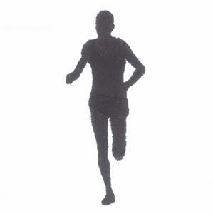

Define a vocabulary of badges
…
vegan
Apple fanboy
runner
photographer
Rich, interpretable and explainable

Slide 12

Define a vocabulary of badges
Identify exemplars
How do I find vegans?

Slide 13
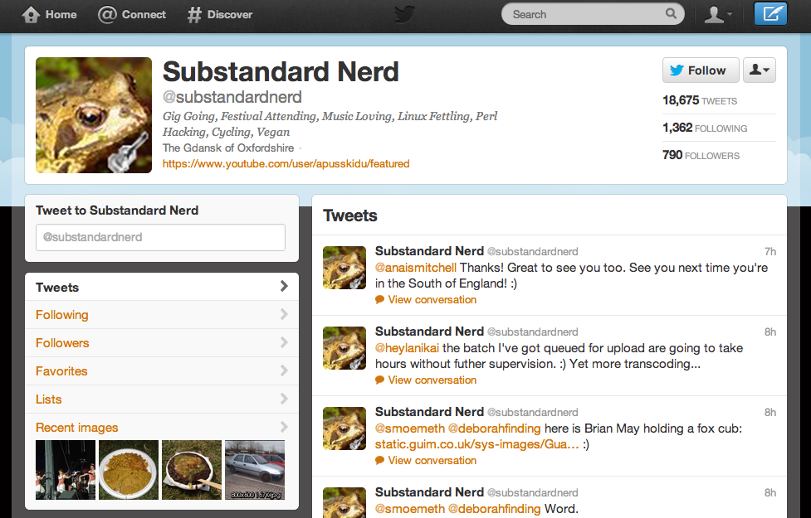
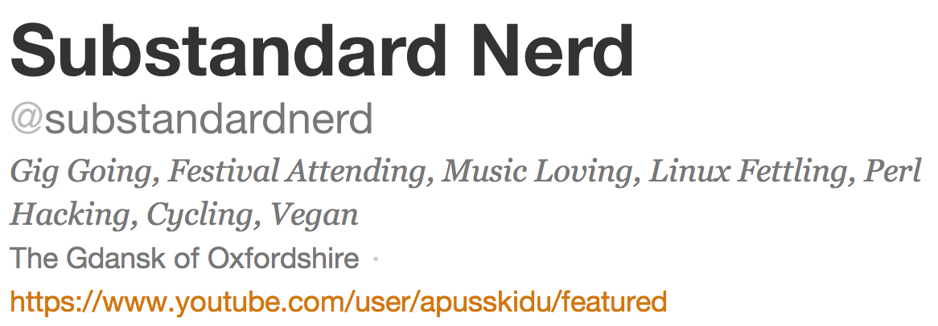
observed label
Take advantage of
how users describe themselves

Slide 14
Most vegans don’t label themselves as “vegan” on Twitter…
we want to infer the attributes of these users

Slide 15
Define a vocabulary of badges
Identify exemplars
Model characteristic behavior
Hashtags #meatlessmonday
Retweets RT @WholeFoods

Slide 16
Approach
Model
Experiments
Summary
Notes:
Model
Experiments
Future Work

Slide 17
Model sketch
We have no negative training examples.
Use a generative model.
Actions can be explained by multiple badges, even for the same user.
Noisy-or to combine badges.
How do we deal with user corrections?
Observing a latent variable.

Slide 18
B badges
i=1…B

Slide 19
N users
i=1…B
u=1…N

Slide 20
j=1…F
i=1…B
F actions
j=1…F
u=1…N

Slide 21
b_{i}^{(u)}
Does user u have badge i?
j=1…F
i=1…B
j=1…F
u=1…N

Slide 22
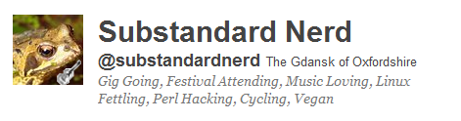
b_{i}^{(u)}
λ_{i}^{(u)}
j=1…F
i=1…B
Does user u have label for badge i in his profile?
j=1…F
u=1…N

Slide 23

b_{i}^{(u)}
λ_{i}^{(u)}
j=1…F
i=1…B
a_{j}^{(u)}
j=1…F
u=1…N
Has user u performed action j?

Slide 24
Does badge i explain action j?
s_{ij}
b_{i}^{(u)}
λ_{i}^{(u)}
j=1…F
i=1…B
a_{j}^{(u)}
j=1…F
u=1…N

Slide 25
s_{ij}
What’s the probability that a user with badge i performs action j?
b_{i}^{(u)}
w_{i}^{(u)}
φ_{ij}
α_{φ}
j=1…F
i=1…B
β_{φ}
a_{j}^{(u)}
j=1…F
u=1…N

Slide 26
s_{ij}
What is the background probability for each action?
b_{i}^{(u)}
w_{i}^{(u)}
φ_{ij}
α_{φ}
j=1…F
i=1…B
β_{φ}
φ_{bg}
a_{j}^{(u)}
j=1…F
u=1…N

Slide 27
s_{ij}
b_{i}^{(u)}
noisy or:
Can at least one of my badges (or the background) explain it?
w_{i}^{(u)}
φ_{ij}
α_{φ}
j=1…F
i=1…B
β_{φ}
φ_{bg}
a_{j}^{(u)}
j=1…F
u=1…N

Slide 28
s_{ij}
b_{i}^{(u)}
λ_{i}^{(u)}
φ_{ij}
α_{φ}
j=1…F
i=1…B
β_{φ}
φ_{bg}
a_{j}^{(u)}
j=1…F
u=1…N

Slide 29
Beta priors to control sparsity
s_{ij}
b_{i}^{(u)}
λ_{i}^{(u)}
φ_{ij}
α_{φ}
j=1…F
i=1…B
β_{φ}
φ_{bg}
a_{j}^{(u)}
j=1…F
u=1…N

Slide 30
α_{T}
β_{T}
α_{F}
β_{F}
Beta prior to encode low recall (e.g., 10%)
γ_{i}^{T}
γ_{i}^{F}
s_{ij}
b_{i}^{(u)}
λ_{i}^{(u)}
φ_{ij}
α_{φ}
j=1…F
Beta prior to encode high precision
(e.g., 99.9%)
i=1…B
β_{φ}
φ_{bg}
a_{j}^{(u)}
j=1…F
u=1…N

Slide 31
α_{η}
β_{η}
α_{ω}
β_{ω}
α_{T}
β_{T}
α_{F}
β_{F}
η_{i}
ω_{i}
γ_{i}^{T}
γ_{i}^{F}
s_{ij}
b_{i}^{(u)}
λ_{i}^{(u)}
φ_{ij}
α_{φ}
j=1…F
i=1…B
β_{φ}
φ_{bg}
a_{j}^{(u)}
j=1…F
u=1…N

Slide 32
Inference
Collapsed Gibbs sampler (with MH steps)
s_{ij}
b_{i}^{(u)}
φ_{ij}
φ_{bg}

Slide 33
α_{η}
β_{η}
α_{ω}
β_{ω}
α_{T}
β_{T}
α_{F}
β_{F}
η_{i}
ω_{i}
γ_{i}^{T}
γ_{i}^{F}
s_{ij}
b_{i}^{(u)}
λ_{i}^{(u)}
φ_{ij}
You behave like a
vegan hipster.
α_{φ}
j=1…F
i=1…B
β_{φ}
φ_{bg}
a_{j}^{(u)}
j=1…F
u=1…N

Slide 34
α_{η}
β_{η}
α_{ω}
β_{ω}
α_{T}
β_{T}
α_{F}
β_{F}
η_{i}
ω_{i}
γ_{i}^{T}
γ_{i}^{F}
s_{ij}
b_{i}^{(u)}
λ_{i}^{(u)}
φ_{ij}
You behave like a
vegan hipster.
α_{φ}
j=1…F
i=1…B
β_{φ}
φ_{bg}
a_{j}^{(u)}
j=1…F
u=1…N

Slide 35
Approach
Model
Experiments
Summary
Notes:
Model
Experiments
Future Work

Slide 36


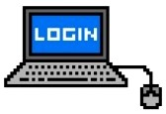


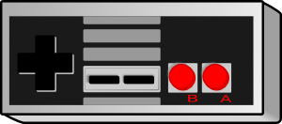

Data description
Start with 7 million Twitter users
Manually define 31 sample badges by specifying labels

Slide 37
Data description
Start with 7 million Twitter users
Manually define 31 sample badges by specifying labels
Gather 2 million tweets from August 2011
Recall: actions are hashtags and retweets
Remove infrequent actions and inactive users, leaving us with:
75,880 users
32,030 actions

Slide 38
Badge statistics
artist
photographer
country music fan
book worm

Slide 39
Can we learn badges?

Slide 40
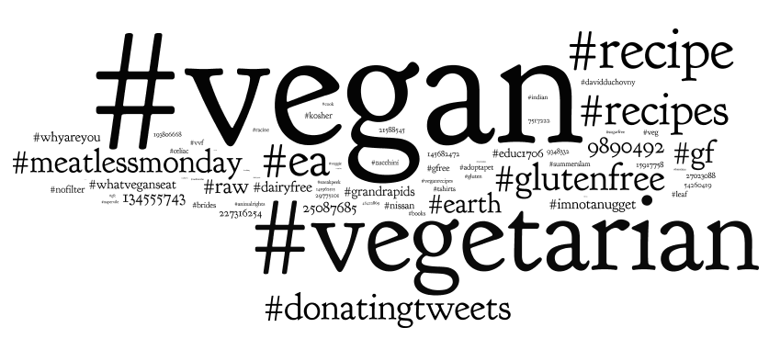
Vegetarian badge

Slide 41
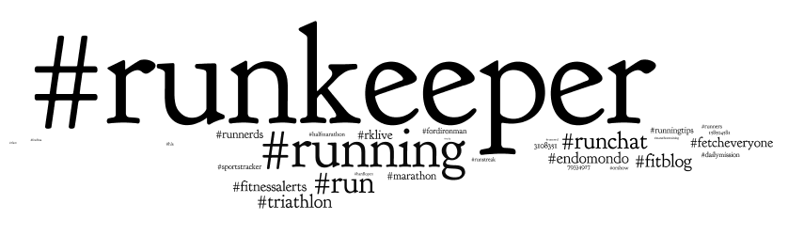
Runner badge

Slide 42
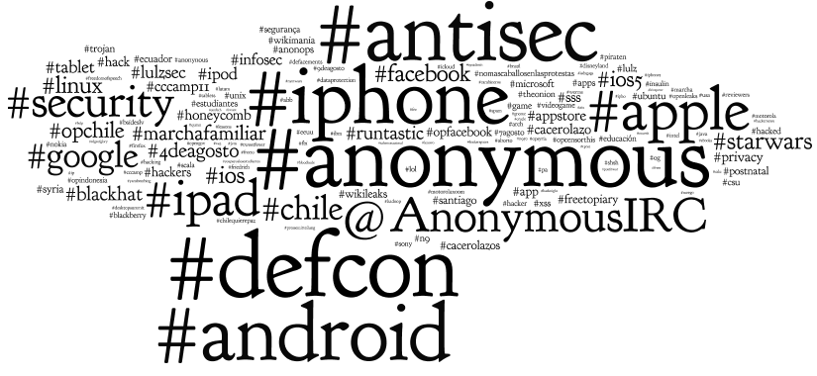
Hacker badge

Slide 43
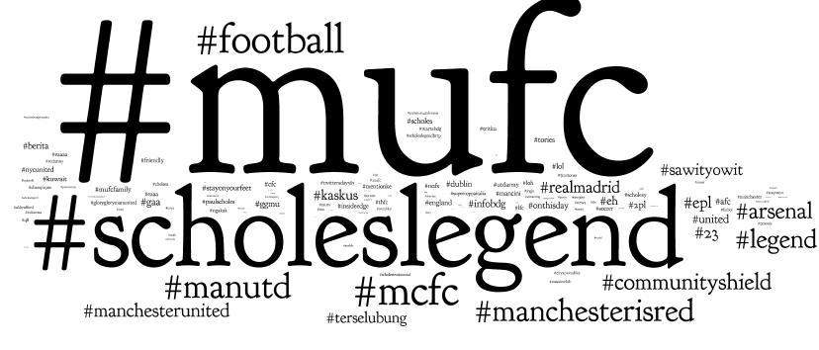
Manchester United badge

Slide 44
Do all badges look this good?
No, but most do.

Slide 45
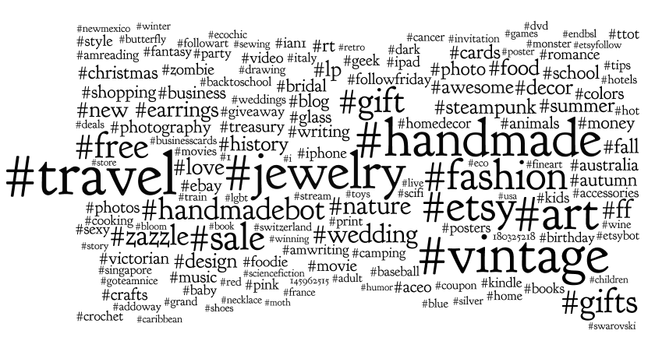
Over-generalized
wine lover

Slide 46
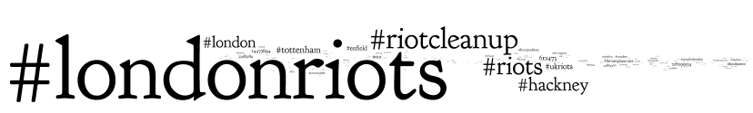
Overwhelmed
Ruby on Rails

Slide 47
Can we just use the labels directly?

Slide 48

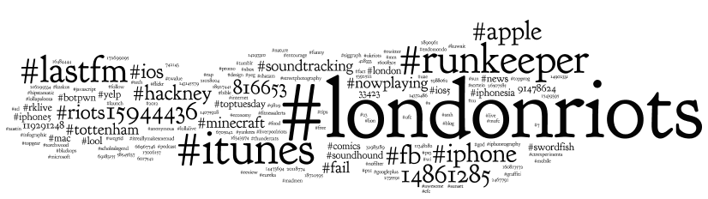
Inferred Apple fanboy badge
Self-described Apple fanboys

Slide 49
Comparative Analysis
Compare to labeled LDA [Ramage+ 2009]
LDA extension where each document is labeled with multiple tags
One-to-one mapping between topics and tags
Document explained only by topics associated with its tags
Hold out random 10% of labels, treat as ground truth, and try to predict them

Slide 50
Rank of held-out labels
Better predictive
performance
better

Slide 51
Better predictions for active users
better

Slide 52
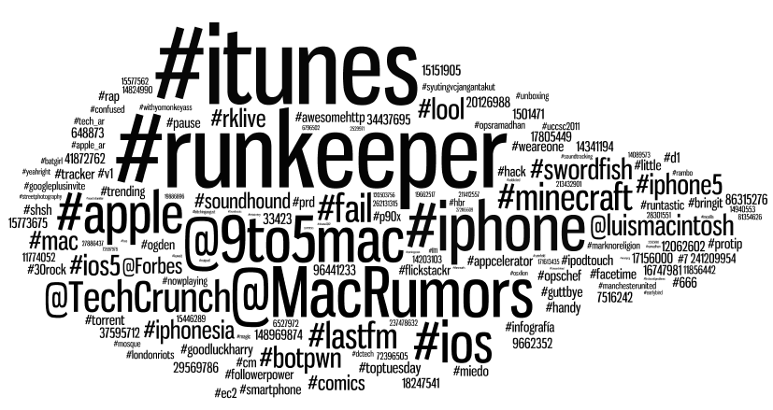
Sparse badges
Apple fanboy (badges)
Apple fanboy (l-lda)

Slide 53
Approach
Model
Experiments
Summary
Notes:
Model
Experiments
Future Work

Slide 54
Leveraged how users describe themselves

Slide 55
Leveraged how users describe themselves to build interpretable user features
You behave like a
vegan hipster

Slide 56
Empirically showed we can infer a user’s attributes from his behavior

Slide 57
谢谢

Slide 58
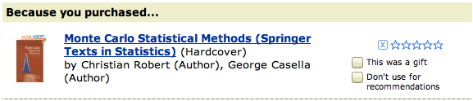

What recourse do we have?
Collaborative filtering
Content-based filtering
Can we do better?

Slide 59
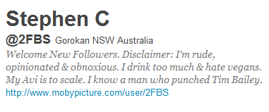
Most vegans don’t label themselves as “vegan” on Twitter…
…but what about non-vegans?
“I drink too much and hate vegans.”

