Slide 1

Representing Documents Through Their Readers
Khalid El-Arini
Min Xu
Emily B. Fox
Carlos Guestrin

Slide 2








overloaded by news
More than a million news articles and blog posts generated every hour*
* [www.spinn3r.com]
Notes:
Spinn3r statistic

Slide 3


a news recommendation engine
user
Vector representation:
Bag of words
LDA topics
etc.
corpus
Notes:
Animate the user in from the right

Slide 4
a news recommendation engine
user
Vector representation:
Bag of words
LDA topics
etc.
corpus
Notes:
Animate the user in from the right

Slide 5

a news recommendation engine
user
Vector representation:
Bag of words
LDA topics
etc.
[Morales+ WSDM 2012]
[Li+ WWW 2010]
corpus
[El-Arini+ KDD 2009]
…
Notes:
Animate the user in from the right

Slide 6

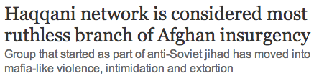
an observation
Most common representations don’t naturally line up with user interests
Fine-grained representations are too specific
High-level topics (e.g., from LDA)
- semantically vague
- can be inconsistent over time

Slide 7
goal
Improve recommendation performance through a more natural document representation

Slide 8
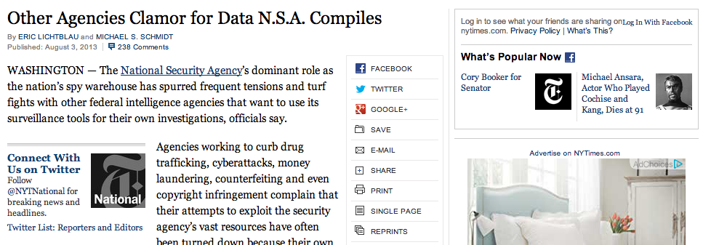
an opportunity: news is now social
In 2012, Guardian announced more readers visit site via Facebook than via Google search

Slide 9
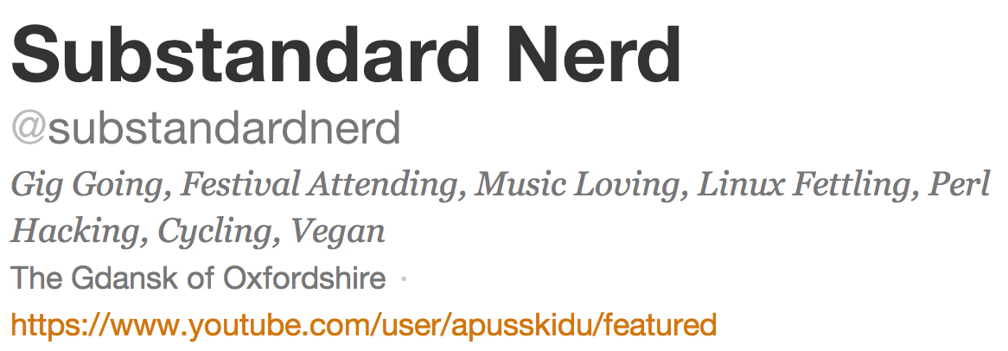
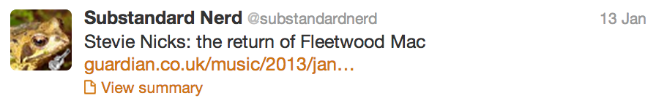
badges

Slide 10
our approach
a document representation based on how readers publicly describe themselves

Slide 11
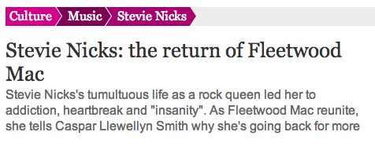

Slide 12
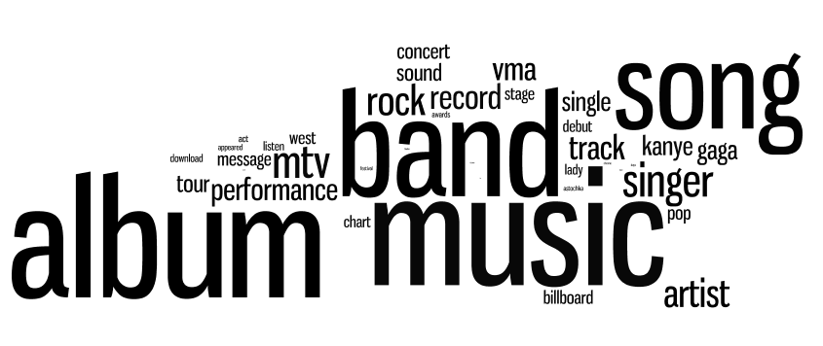
From many such tweets, we learn that someone who identifies with
music
reads articles with these words:

Slide 13
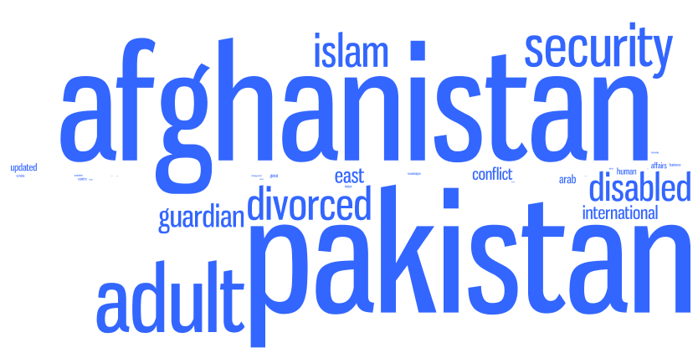
Given: training set of tweeted news articles from a specific period of time
1. Learn a badge dictionary from training set
2. Use badge dictionary to encode new
documents
3 million articles in our experiments
music
words
badges

Slide 14
advantages
Interpretable
Clear labels
Correspond to user interests

Slide 15
advantages
Interpretable
Clear labels
Correspond to user interests
Higher-level than words

Slide 16
advantages
Interpretable
Clear labels
Correspond to user interests
Higher-level than words
Semantically consistent over time
politics

Slide 17
Given: training set of tweeted news articles from a specific period of time
1. Learn a badge dictionary from training set
2. Use badge dictionary to encode new
documents
3 million articles in our experiments
music
words
badges

Slide 18
learning the dictionary
Training data (for time period t):
Bag-of-words representation of document
Identifies badges in Twitter profile of tweeter
album
Fleetwood Mac
love
Nicks
gig
music
cycling
linux

Slide 19
learning the dictionary
Training data (for time period t):
Bag-of-words representation of document
Identifies badges in Twitter profile of tweeter
album
Fleetwood Mac
love
Nicks
gig
music
cycling
linux

Slide 20
learning the dictionary
Training data (for time period t):
Model:
Bag-of-words representation of document
Identifies badges in Twitter profile of tweeter
V x 1
K x 1
V x K
sparse, non-negative dictionary

Slide 21
learning the dictionary
Optimization
Efficiently solve via projected stochastic gradient descent, allowing us to operate on streaming data

Slide 22
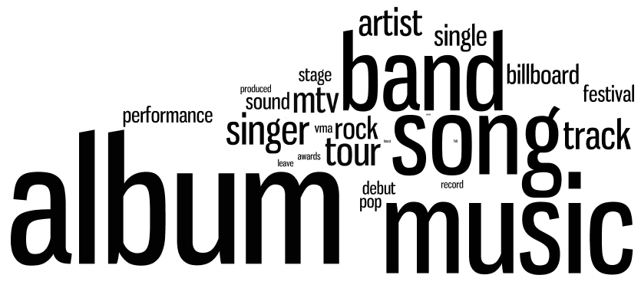
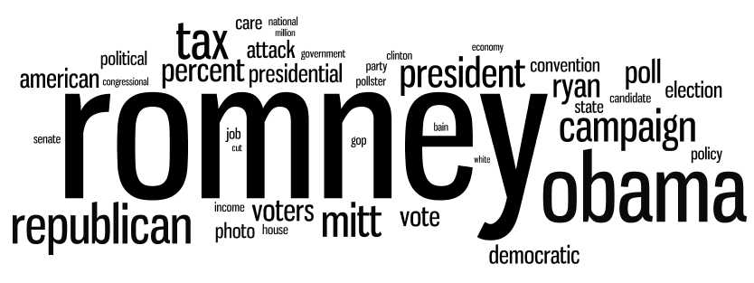
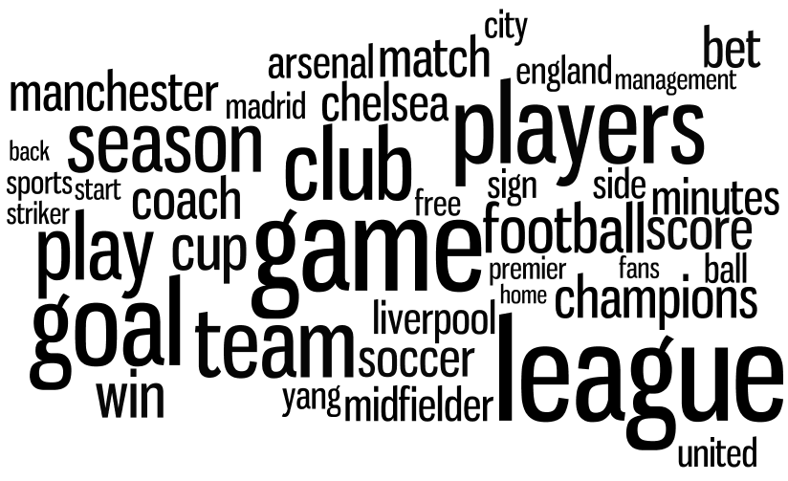
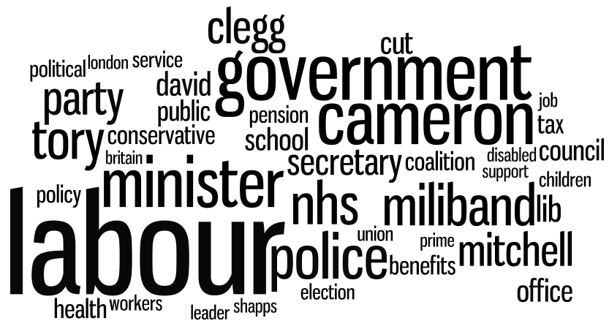
examining B
September 2012
music
Biden
soccer
Labour
Notes:
Music
Soccer
Labour
Biden
tennis

Slide 23
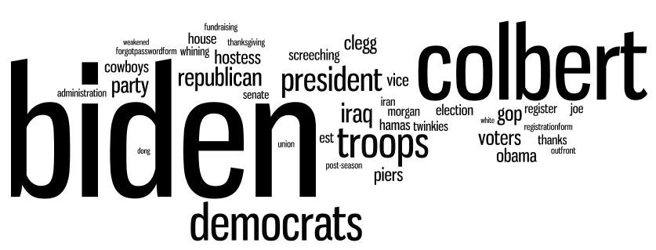
badges over time
September 2012
music
Biden
September 2010
Notes:
Music
Soccer
Labour
Biden
tennis

Slide 24
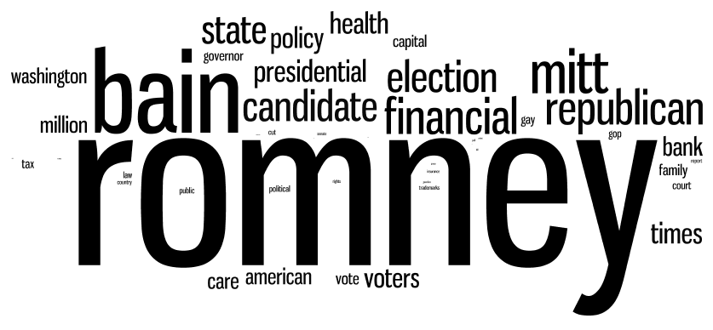
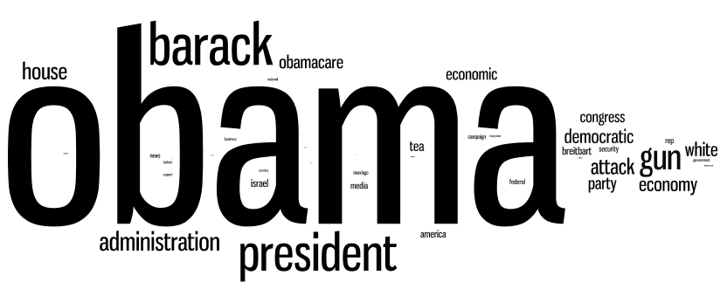
dueling badges
progressive – TCOT
TCOT– progressive
July 2012

Slide 25
Given: training set of tweeted news articles from a specific period of time
1. Learn a badge dictionary from training set
2. Use badge dictionary to encode new
documents
3 million articles in our experiments
music
words
badges

Slide 26
coding the documents
Can we just re-use our objective, but fix B?
Problem case:
Two articles about Barack Obama playing basketball
Lasso problem arbitrarily codes one as {Obama, sports} and the other as {politics, basketball}
No incentive to pick both “Obama” and “politics” (or both “sports” and “basketball”), as they cover similar words
Leads to extremely related articles being totally dissimilar
How do we fix this?

Slide 27
a better coding
Problem occurs because vanilla lasso ignores relationships between badges
Idea: use badge co-occurrence statistics from Twitter

Slide 28
a better coding
Problem occurs because vanilla lasso ignores relationships between badges
Idea: use badge co-occurrence statistics from Twitter
Define weight w_{s,t} to be high for badges that co-occur often in Twitter profiles
Graph-guided fused lasso [Kim, Sohn, Xing 2009]

Slide 29
recap
1. Learn a badge dictionary from training set
2. Use badge dictionary to encode new
documents
music
words
badges

Slide 30
experimental results
Case study on political columnists
User study
Offline metrics

Slide 31
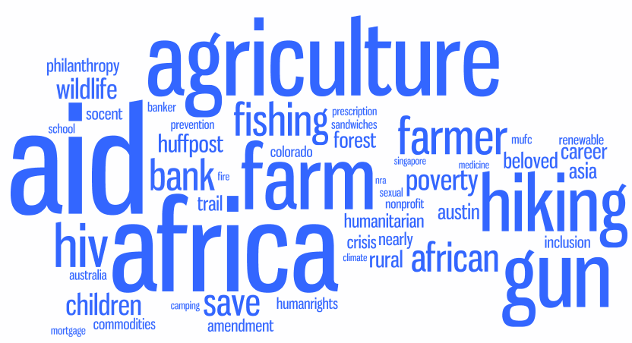
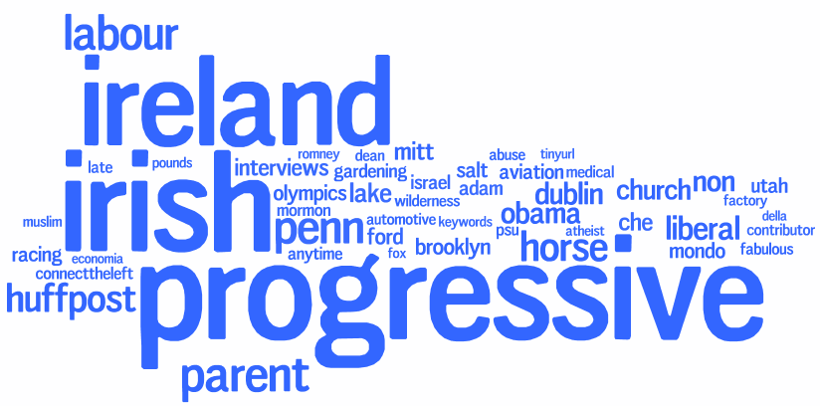
coding columnists
Downloaded articles from July 2012 for fourteen prominent political columnists
Coded the articles via badge dictionary learned from same month
Nicholas Kristof
Maureen Dowd

Slide 32
a spectrum of pundits
“top conservatives on Twitter”
Limit badges to progressive and TCOT
Predict political alignments of likely readers?
more conservative

Slide 33
experimental results
Case study on political columnists
User study
Offline metrics
User study shows badges better document representation than LDA topics or tf-idf when recommending news articles across time
Offline analysis shows badges are more thematically coherent than LDA topics

Slide 34
user study
The fundamental question:
Which representation best captures user preferences over time?
Study on Amazon Mechanical Turk with 112 users
Steps:
Show users random 20 articles from Guardian, from time period 1, and obtain ratings
Pick random representation (tfidf, LDA, badges)
Represent user preferences as mean of liked articles
Use probabilistic max-cover* to select 10 related articles from a second time period
* [El-Arini+ KDD 2009]

Slide 35
user study
better

Slide 36
summary
Novel document representation based on user attributes and sharing behavior
Interpretable
Consistent over time
Case studies provide insight into journalism and politics
Improved recommendation of news articles to real users

